Slide 1


Python Web apI - Restful
schema / documentation

Slide 2
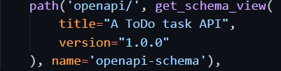
Generate Openapi schema
Add a new url, and the view from rest_framework

Slide 3
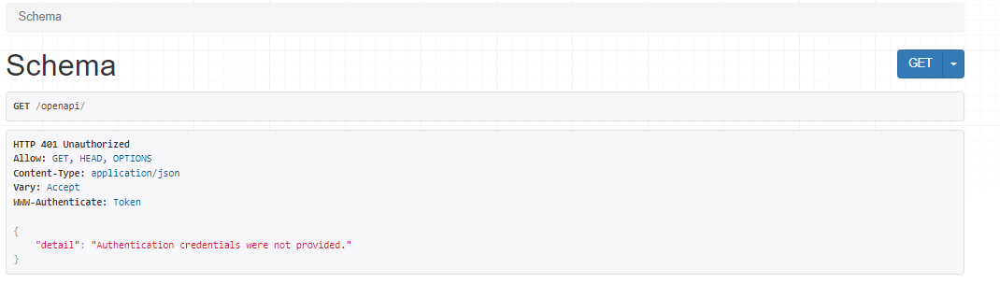
Check with browser
Project default need user be authenticated.

Slide 4
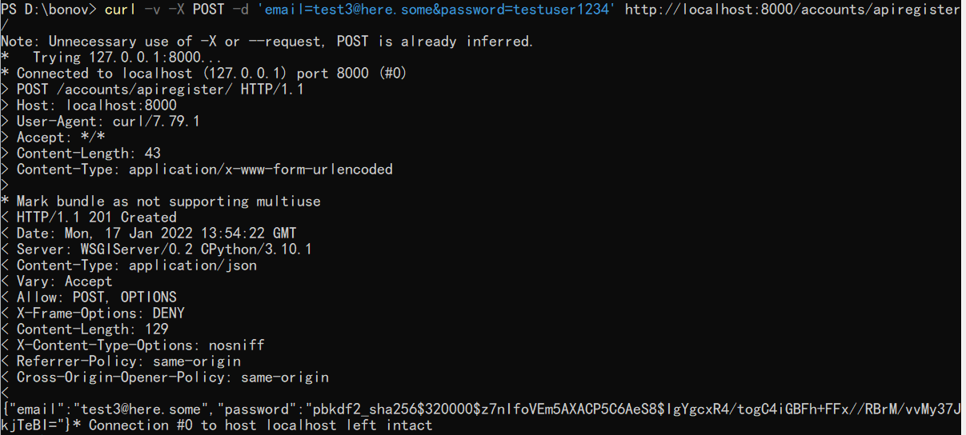
Using curl to provide auth-token
User POST to create a new user. Can use admin to check user is not active

Slide 5
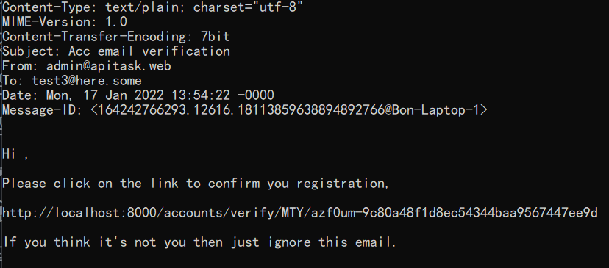
Verify email

Slide 6
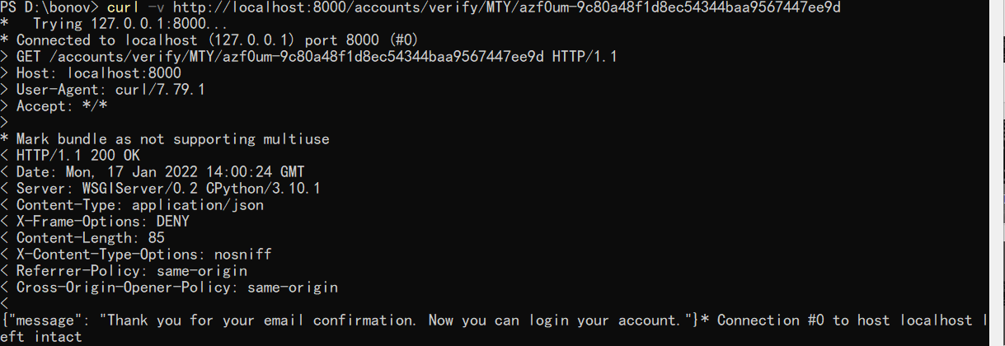
User curl to finish the verify

Slide 7
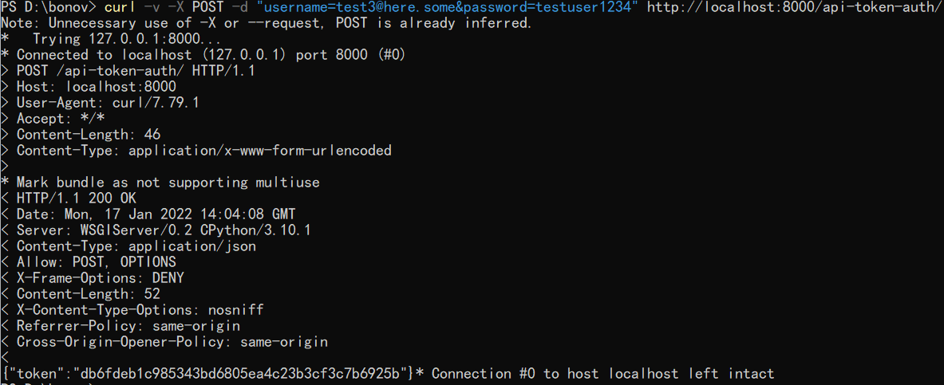
Use curl to get auth-token

Slide 8
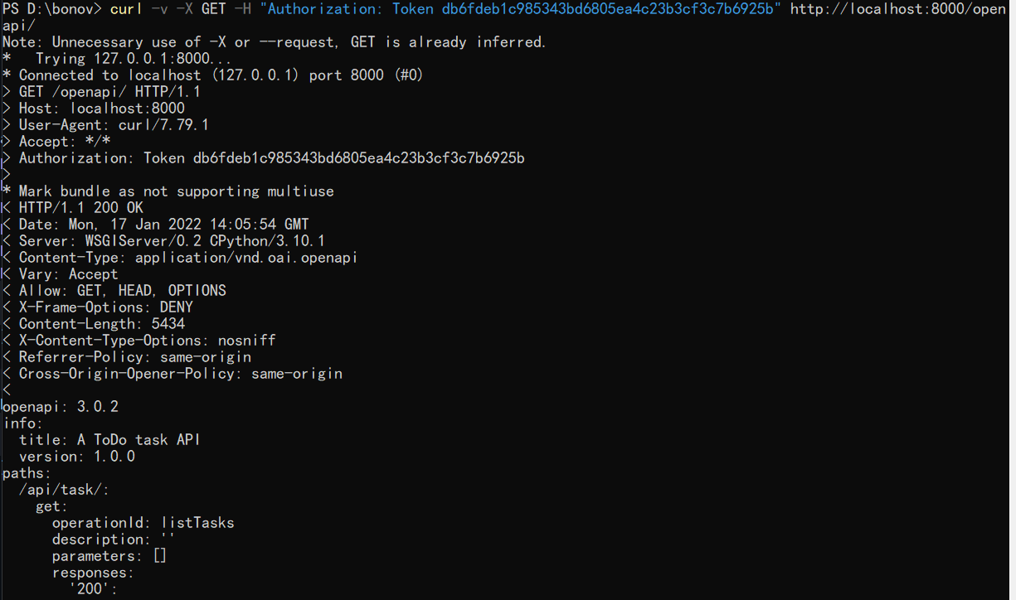
User curl get schema

Slide 9
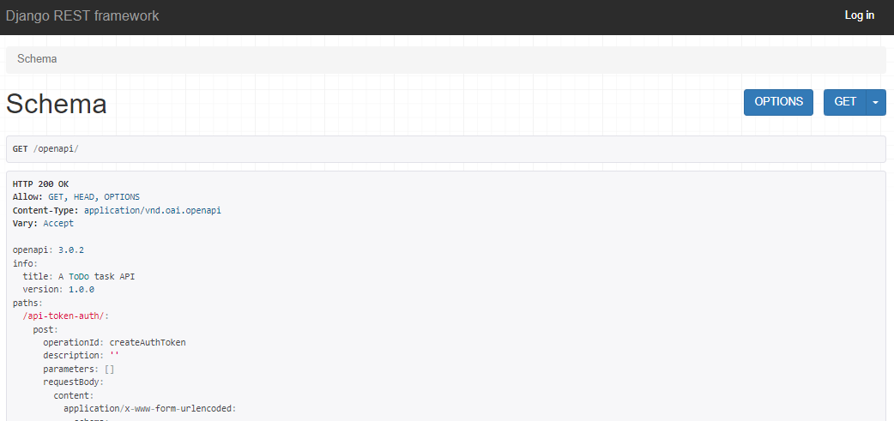
Change permission settings
Change project level default to IsAuthenticatedOrReadOnly, allow any person to have readonly by default.

Slide 10
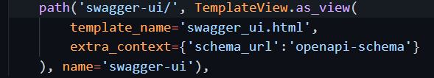
Add documentation
url

Slide 11
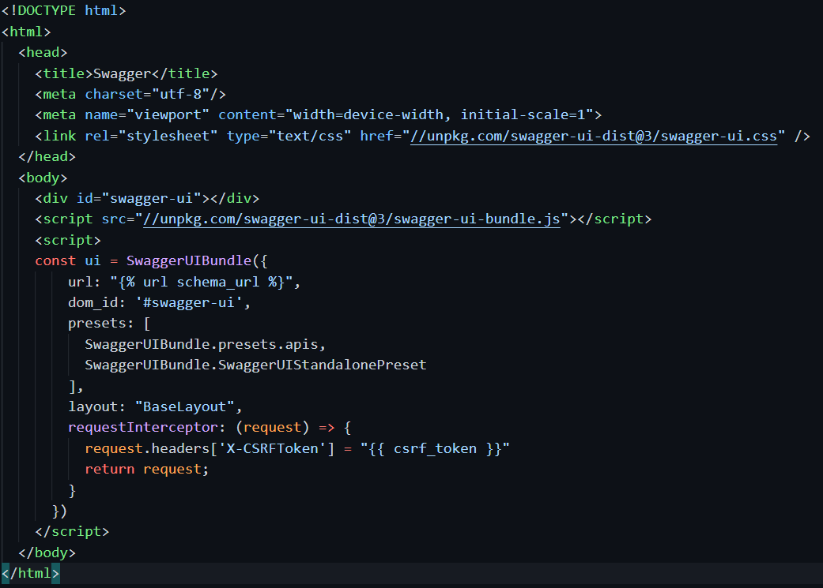
Add documentation template

Slide 12
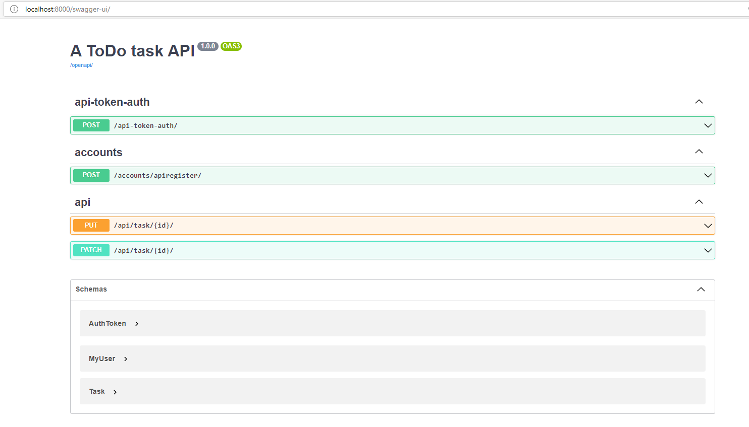
Check with browser

